Slide 1
MACHINE LEARNING HDIP IN DAB CCT College Dublin COVID-19
Emily Cristina Herbas Luizaga (2023100)
Lecturer: Dr. Muhammad Iqbal

Slide 2
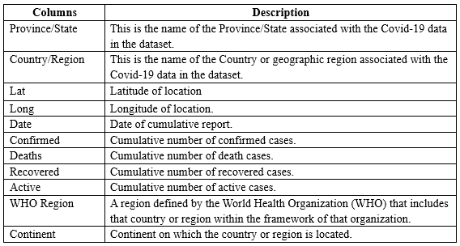
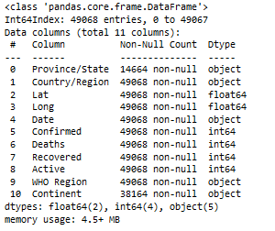
Data One of my first contributions was to find the dataset that fits the requirements requested in the assigment ( at leat 8000 rows and 10 columns)

Slide 3
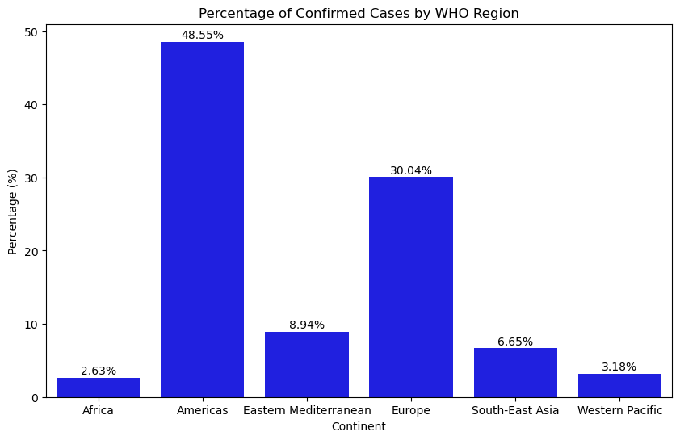

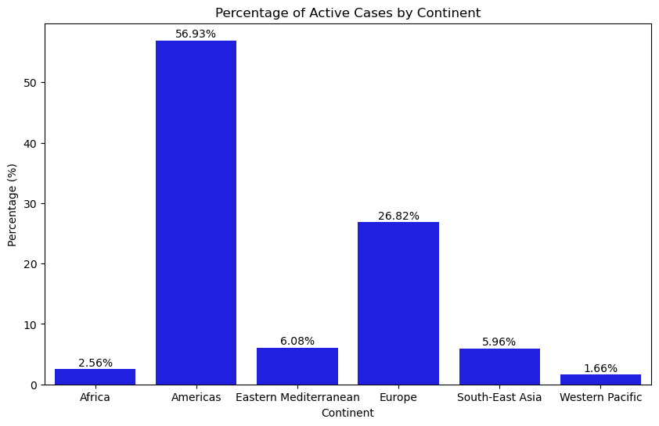
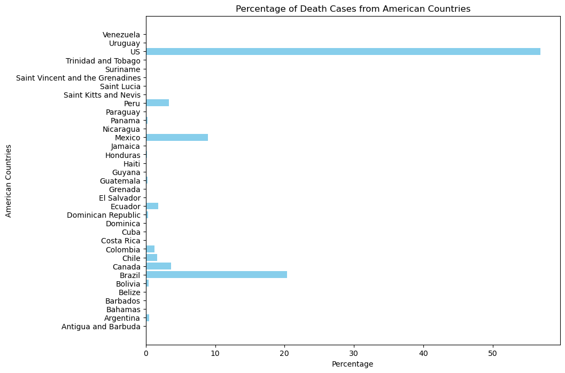
Data visualization
I did the visualization of the different cases of COVID (Confirmed, Deaths, Recovered, Active) for a better understanding of hoe the virus affected the WHO Regions and Country levels.

Slide 4
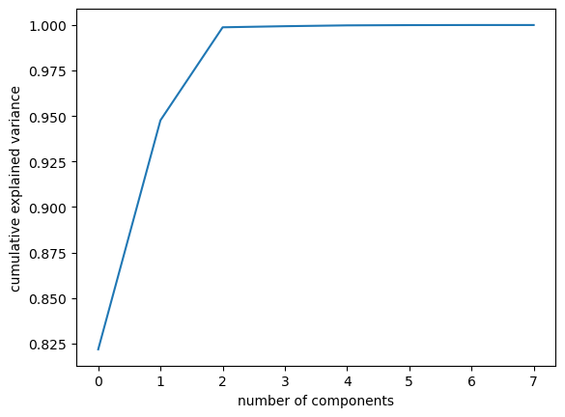
Dimensionality reduction
pca
We applied the PCA for the Confirmed cases and we reduce our columns from 8 to 3.

Slide 5
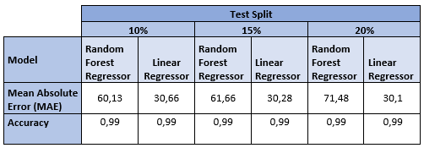
Hyperparameter Tuning with Random Forest Regressor and Linear Regression
I applied the models for different splits of testing and training.

